Slide 1
The Battle of Neighborhoods
Coursera Final Project
Chinese Mall Locating
By Volha Pleskatsevich

Slide 2
Agenda
Choosing the best Borough of New York City for the location of the Chinese Mall.
This seems like a simple task, because Chinese goods have a significant price advantage. However, I assume that cheap Chinese goods will use the highest demand precisely in places with a greater concentration of people from China and India, since they are more accustomed to such goods. In addition, for my analysis, I make the assumption that it is quite profitable to locate such stores near other shopping centers, where people accumulate specifically for shopping and leisure.

Slide 3
Objectives
Get data on 5 boroughs of New York
Analyze data on the presence of Movie Theatres, Chinese restaurants, Indian restaurants and Shopping Malls in each of the borough
Compare features of neighborhoods from different to gather enough insight to determine which neighborhood choose the better location for a new Chinese mall

Slide 4
To do this, I will follow 3 basic steps:
Analysing the datasets of 5 boroughs
Getting top 100 popular venues within for a given neighbourhood Using Forsquare APIs
Exploring and analyzing the data of each borough

Slide 5
Libraries to use
Pandas - Library for data analysis
NumPy - Library to handle data manipulation
Sklearn - Library to handle k-mean clustering
Requests - Library to handle http requests
JSON - Library to handle JSON files
Geopy - Library to pull location data
Matplotlib - Library for data visualization
Folium - Map rendering library

Slide 6
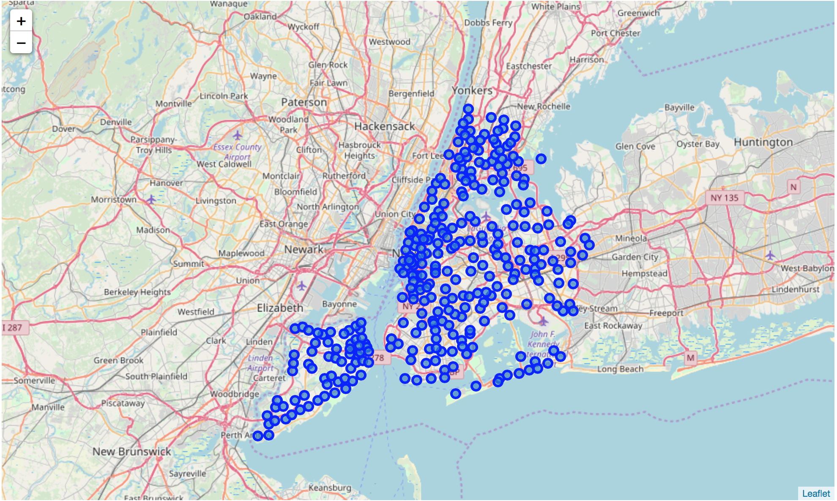
Folium map of New York

Slide 7
Data
The data we need is available for free at NYU Spatial Data Repositoy, and can be downloaded from: https://geo.nyu.edu/catalog/nyu_2451_34572
For the purpose of this project, the file which has already been downloaded on a server has been used. Its location is: https://ibm.box.com/shared/static/fbpwbovar7lf8p5sgddm06cgipa2rxpe.json

Slide 8
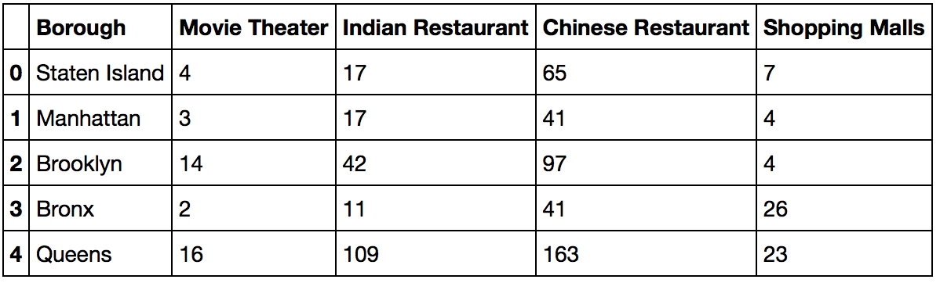
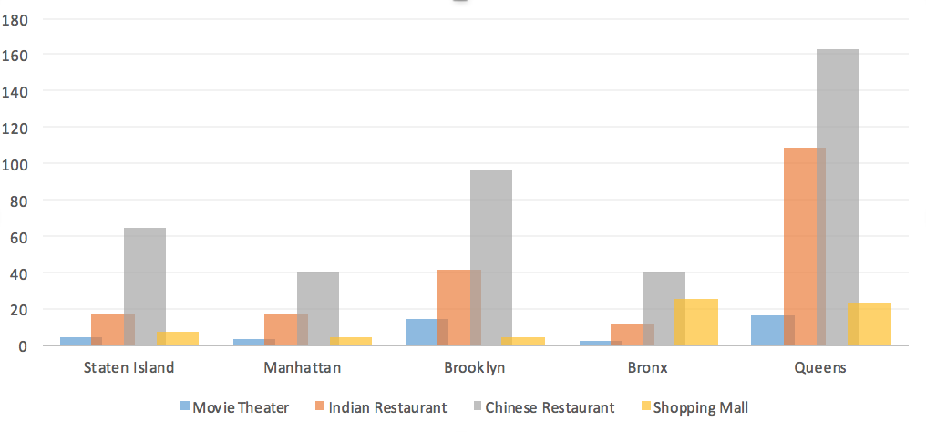
Results

Slide 9
Conclusion
Thanks to the most developed necessary infrastructure of Queens Borough, it can be concluded that the construction of the Chinese Mall is better to produce there.

